Slide 1
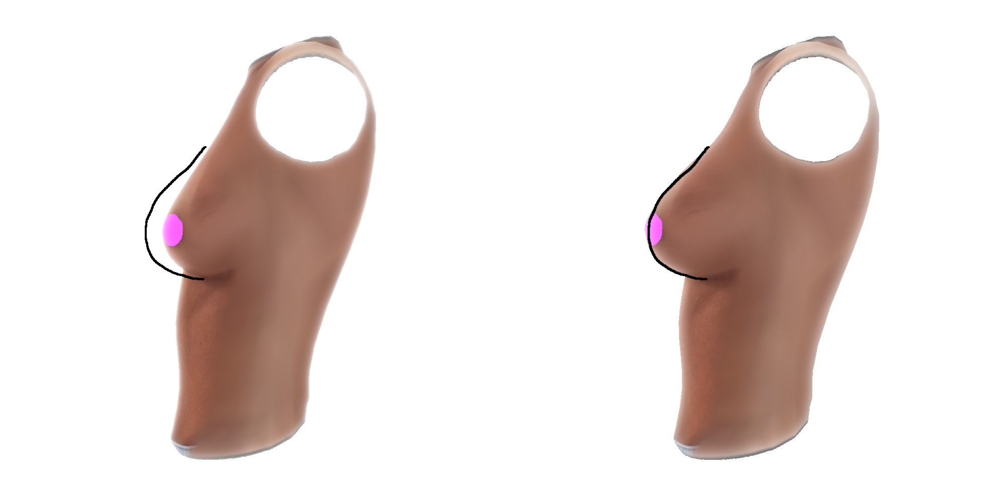
Cross-platform Real-time Visualization and Editing Interface of Breast 3D meshes

Slide 2

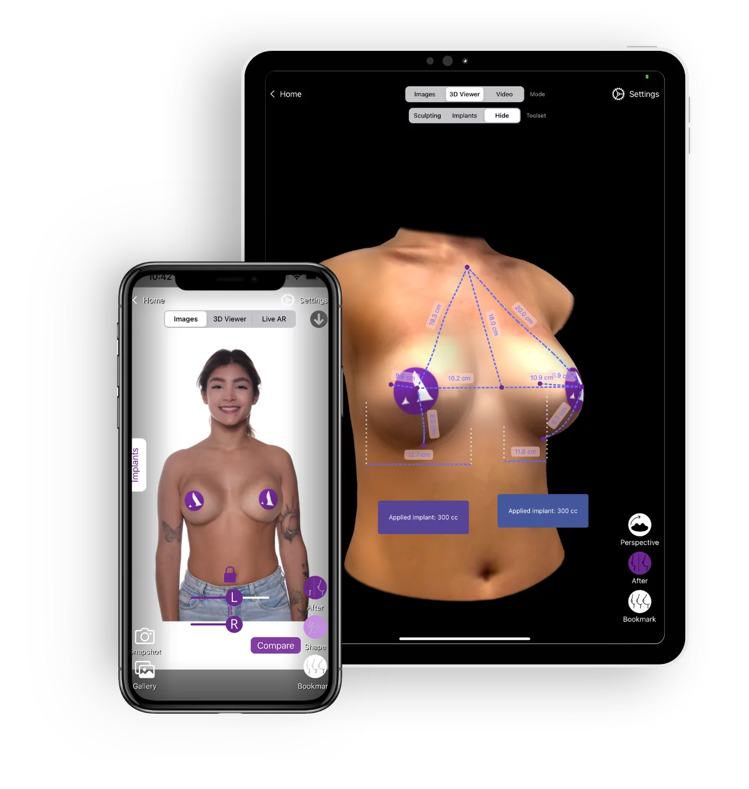
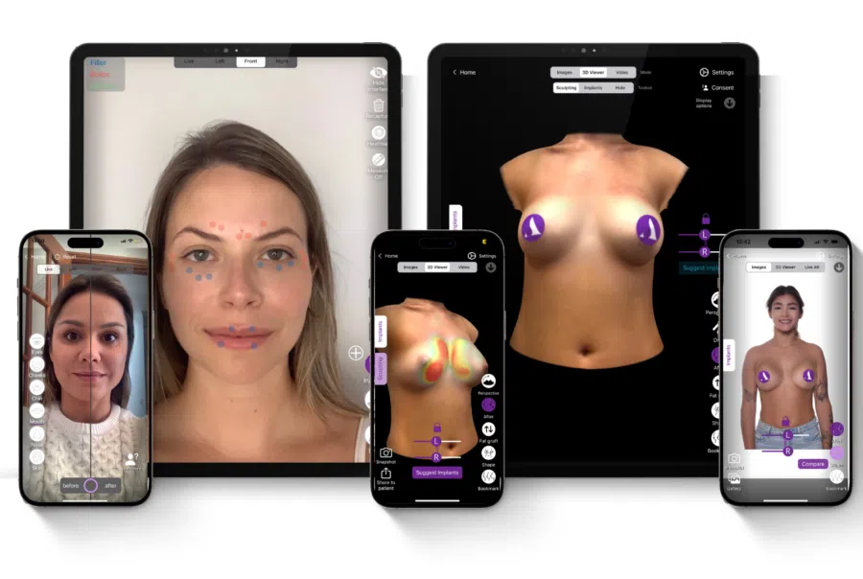

Slide 3
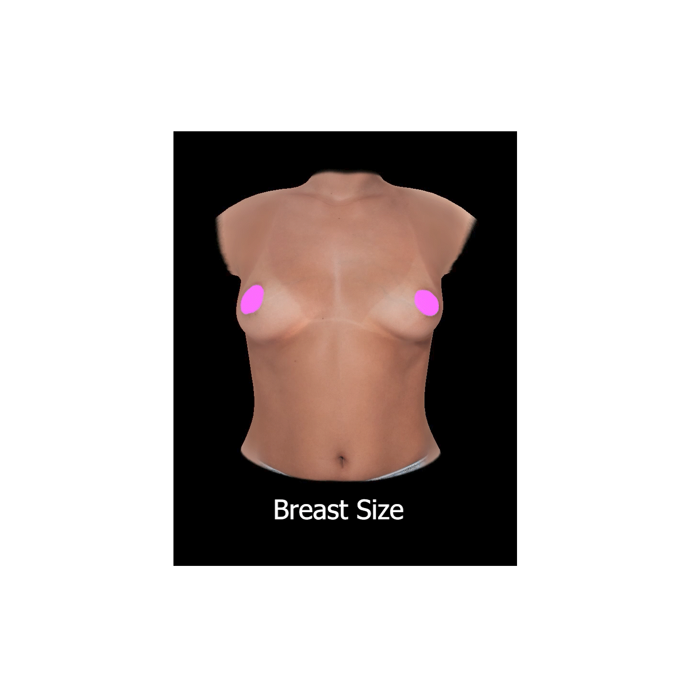
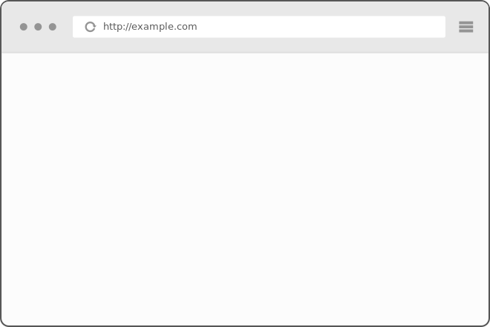
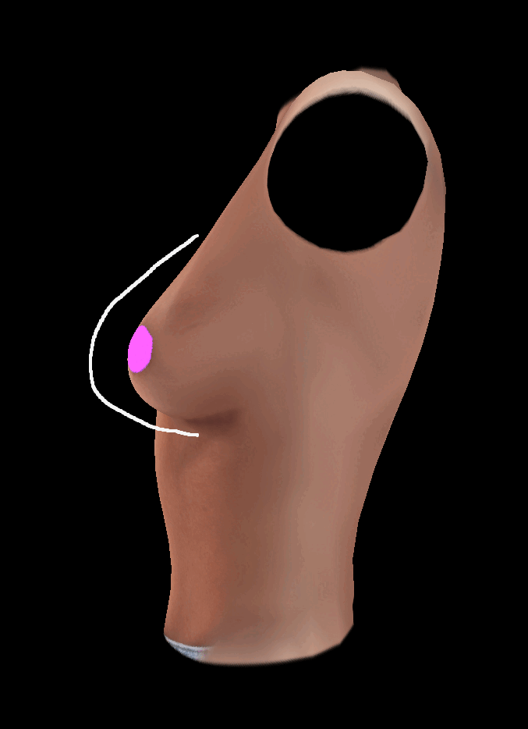


Challenges

Slide 4



Scan
Modify
Compare
Notes:
In application provide user with these 3 functionalities
Scan, get patient data
Modify and compare require visualization of 3d model

Slide 5
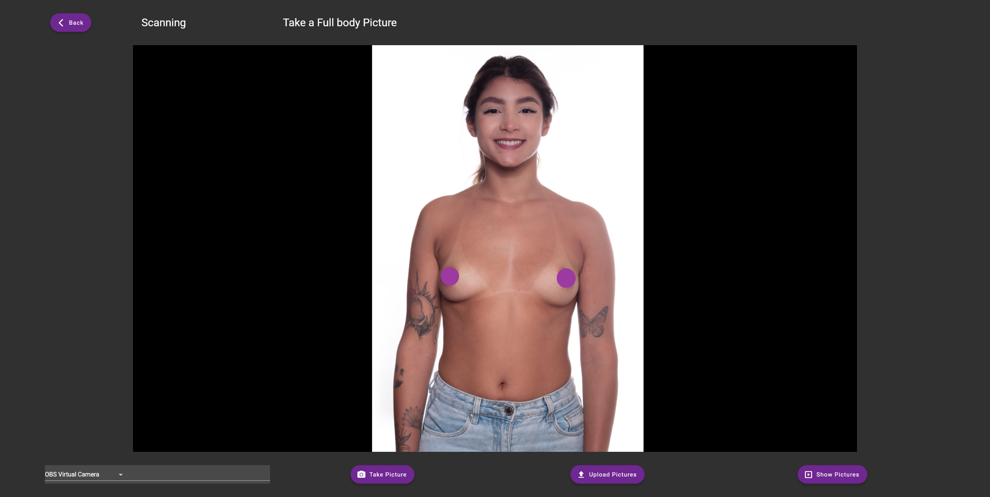
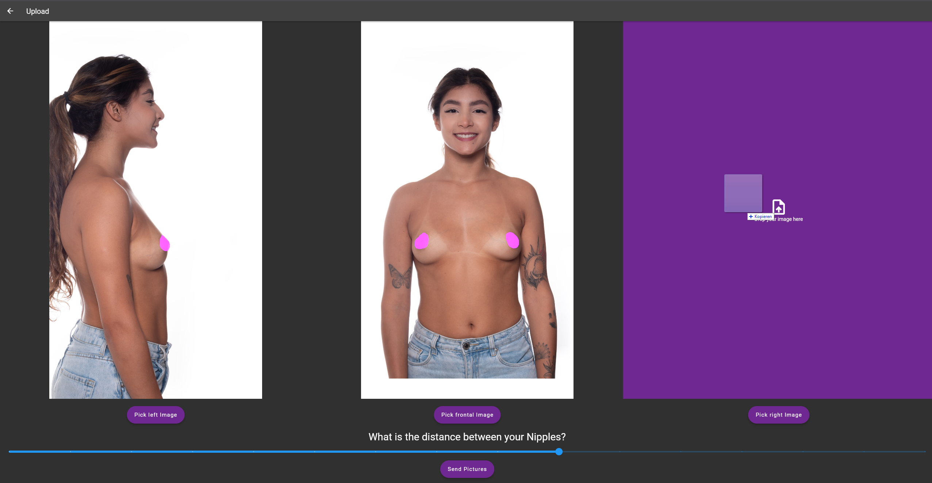
Notes:
Two options
-camera widget for live usage, imagine doctor
-upload for machines without camera, bad lightning, etc
In web: limitation not simply access devices memory, extra conversion into BLOB(Binary Large Object), represents file-like object, immutable, raw data, often used in webdeveloppment

Slide 6
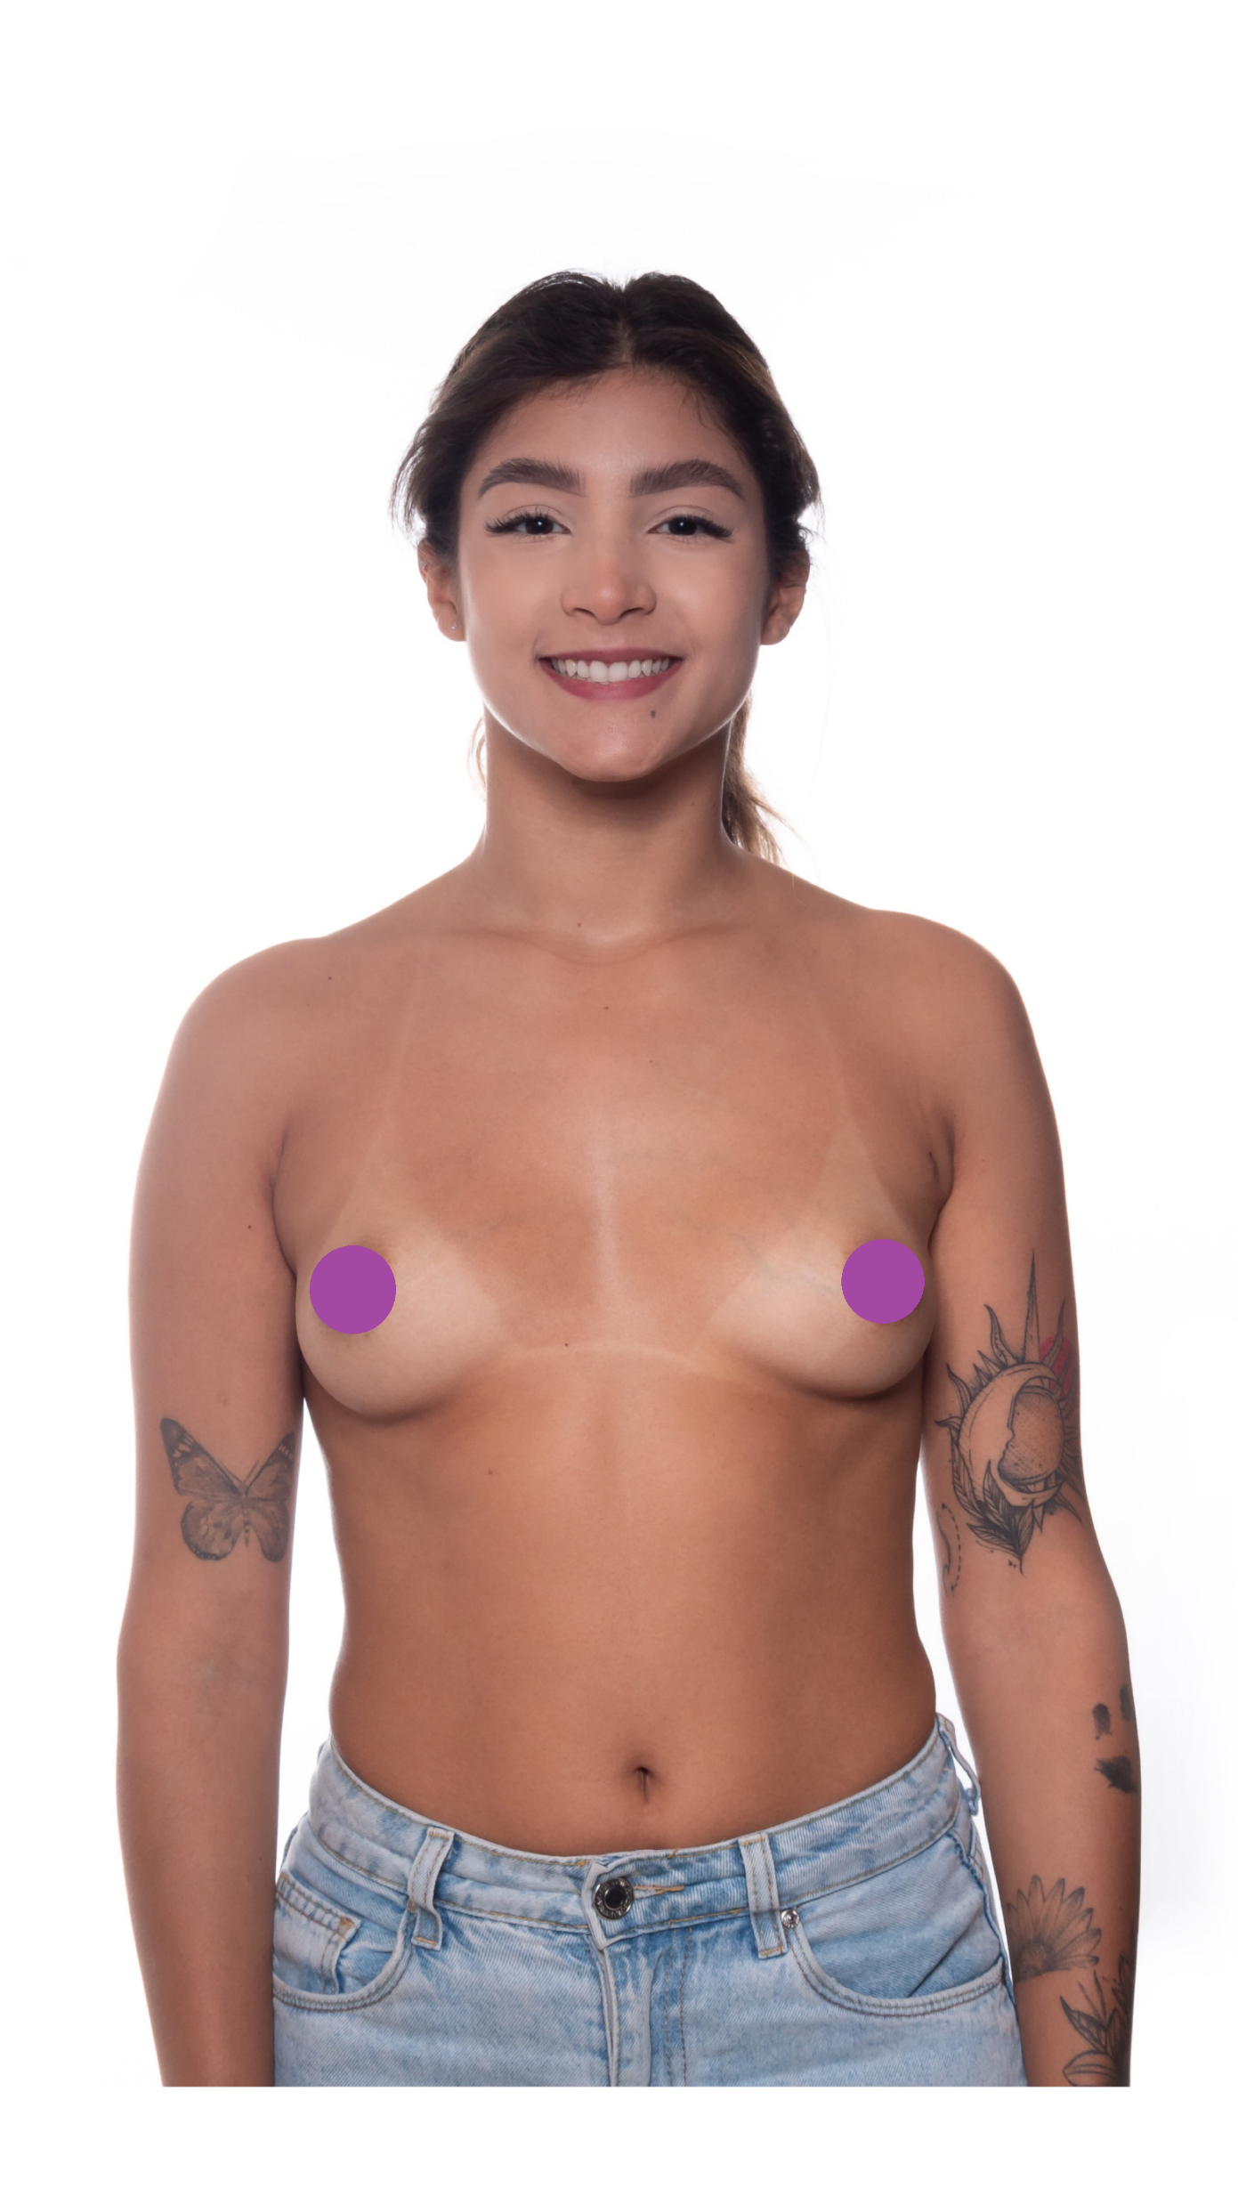
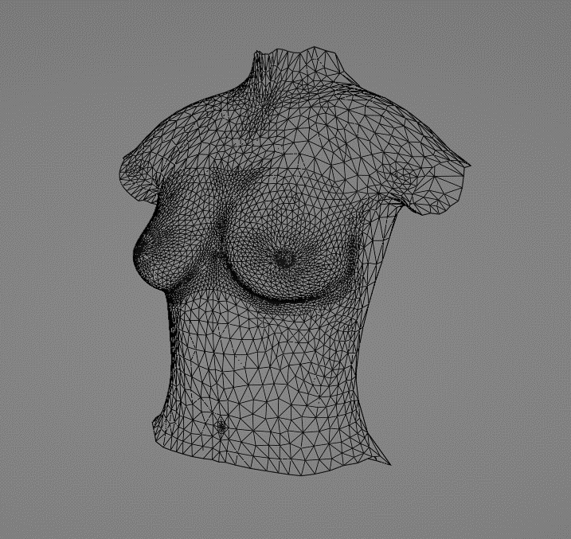


Notes:
We want to protect our method, so someone else can’t simply copy it.
Decided to perform this task on server owned by arbrea. Simple server that gets sent 3 images, and distance between the nipples, runs the pipeline, and then returns the 3D object.
Decided to do in python.

Slide 7
Displaying Model
Adapted Flutter Cube Package
Standard Graphics Pipeline
Wavefront obj files
Notes:
-For displaying adapted flutter cube package from pub, the package manager of flutter. Widget used to display obj files.
-Standard graphics pipeline
-Uses obj representation, we directly read them into cube after receiving them

Slide 8

Model Modification
PCA
Correction UI
Notes:
After having the data made available, we now want to present the user with two methods to change and visualize the 3D model, to “simulate” a surgical procedure
-first method PCA, resulting in model change through sliders
-second method correction UI, resulting in an automated, adaptive selection of the PCA parameters

Slide 9
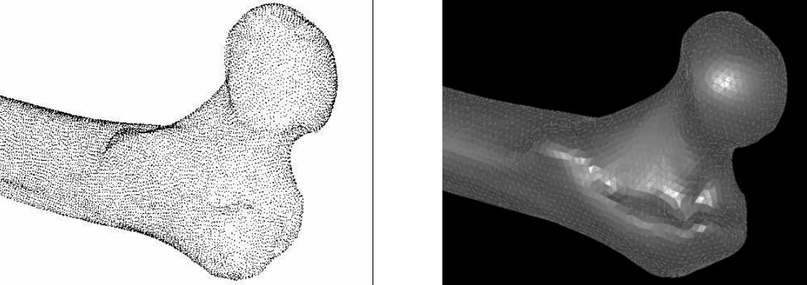
PCA
APPLICATIONS OF 3D PCA METHOD FOR EXTRACTION OF MEAN SHAPE AND GEOMETRICAL FEATURES OF BIOLOGICAL OBJECTS SET
by M. Rychlik, W. Stankiewicz and M. Morzynski
Arbrea’s Solution
Notes:
To fit PCA and analyze data we decided to use Python, together with libraries like SciPy. Because in the end it is matrix multiplication the transfer to flutter is straight forward.
Dataset of 266 torso models, provided
Related Work Arbrea Labs and APPLICATIONS OF 3D PCA METHOD FOR EXTRACTION OF MEAN SHAPE AND GEOMETRICAL FEATURES OF BIOLOGICAL OBJECTS SET 2008

Slide 10
Important PCA Parameters

Slide 11
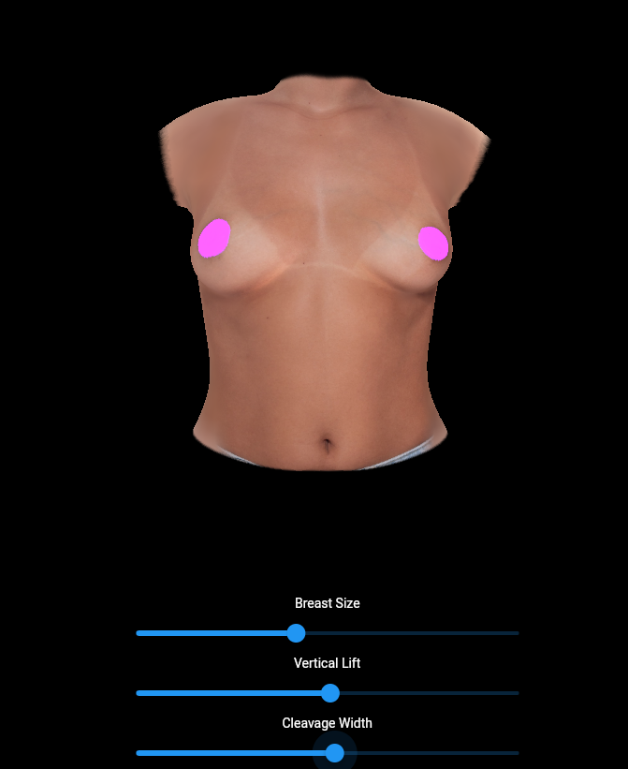
Notes:
In our application we can now change the principal components to plus/minus 3 standard deviations, which captures 99.73% of all shapes
Since principal components also affect torso, not only breast, we only change the breast area, interpolating at the boundarys

Slide 12
Correction UI
Notes:
With our correction UI we want to do as the picture describes: draw line on screen, then let the software adjust the PCA parameters so the breast silhouette aligns with the line

Slide 13
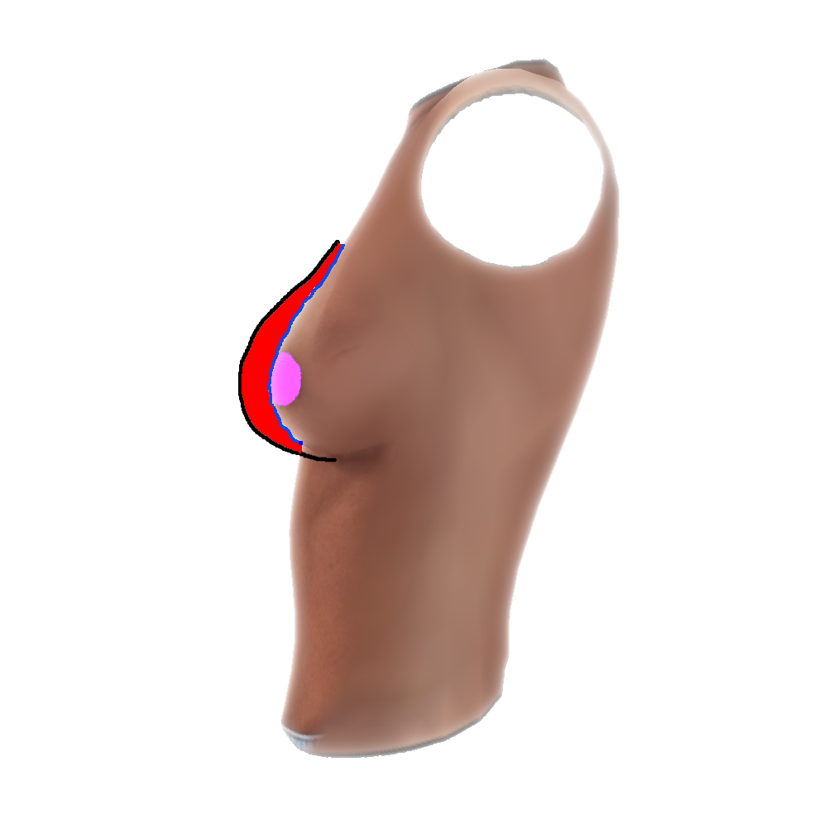
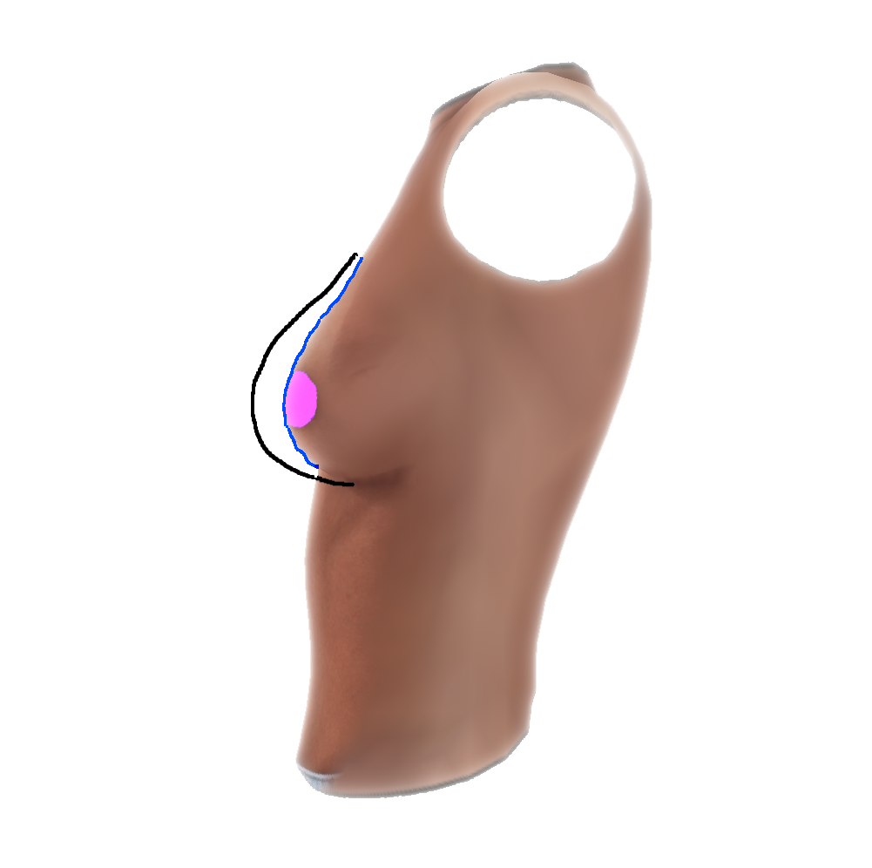
Notes:
In practice this means that we need to get the plane in 3D corresponding to the line (black line), and the 3D coordinates of the silhouette, which is a line in 3D(blue line)

Slide 14
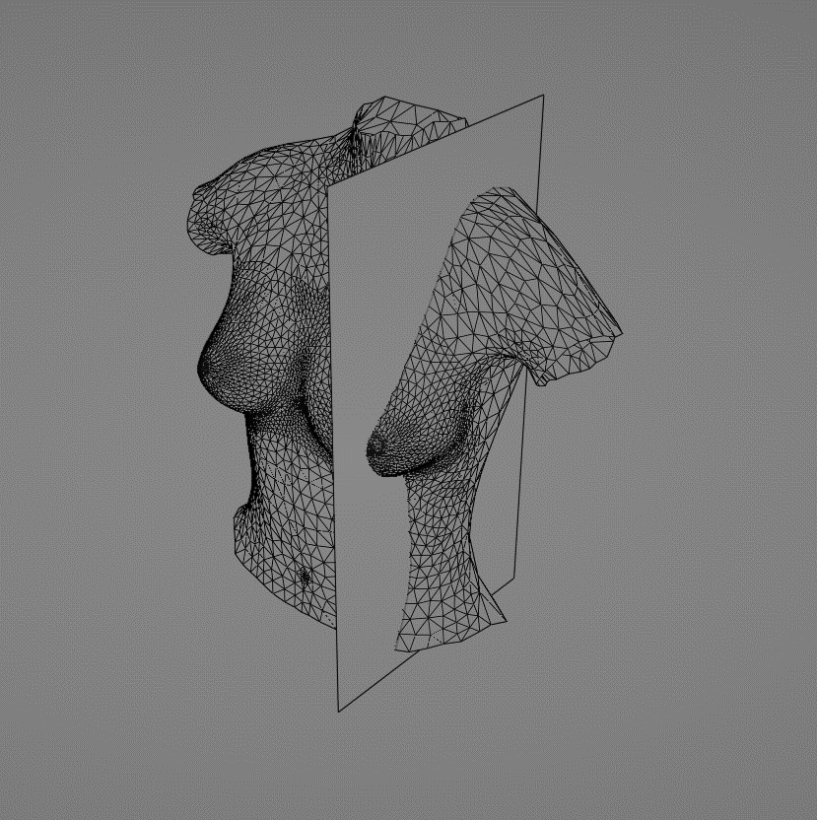
Simplifications
Line => set of points
Silhouette and line on constant yz-plane
=> silhouette consists of same vertices
Integral => sum over distances
Notes:
In order to solve this we made some necessary simplifications to the problem.
-First we assume the drawn line is represented by a set of points in 3D space, instead of a plane, or some more complex mathematical representation(spline)
-This line and the silhouette are on a constant yz plane, defined by some constant x. This allows us to have the silhouette represented by the same vertices
-The term to minimize is now a sum over distances instead of an integral(area)

Slide 15
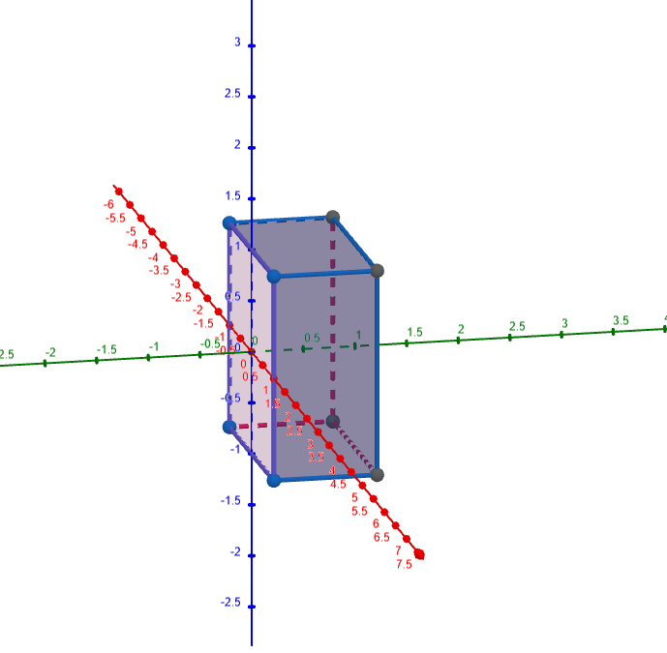
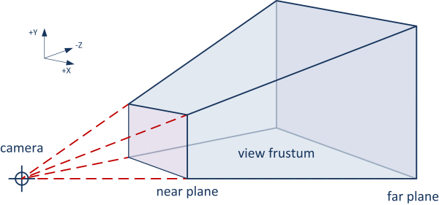
Back Projection
Notes:
We need drawn line in object space, but we only have uv coordinates of the pixels drawn on the screen. To solve this we need to backproject the uv coordinates into 3D.
Since we know the transformation matrices that get applied in the graphics pipeline(Cube), we can reverse the process.
To get a 3D point of a 2D point, we first set two points in the Cubus, one on the near plane, one on the far plane, both with the (x,y) coordinates of the point in the image.
We then apply the inversed transformation matrix to both points and get the points in object space. We can then draw a line connecting the two points.
When we intersect this line with the constant yz plane we get the desired 3D point

Slide 16
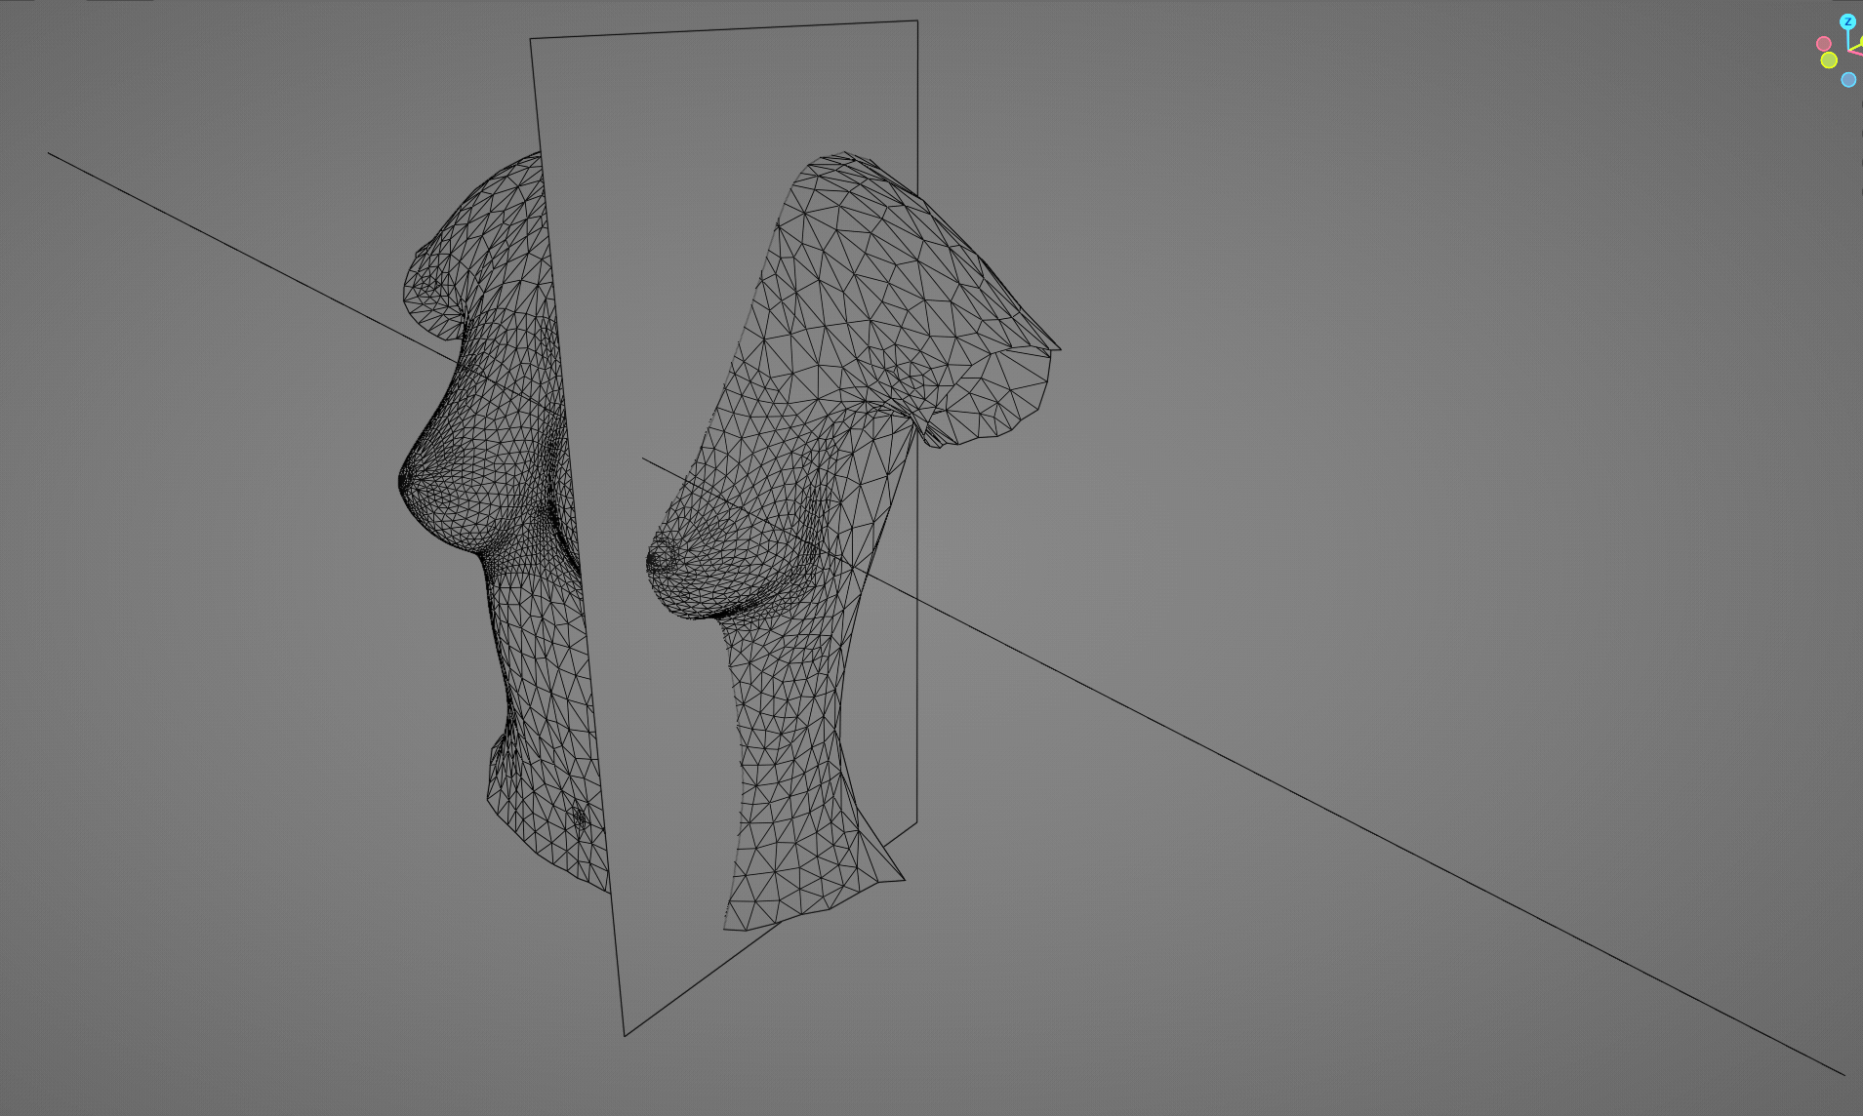
Back Projection
Notes:
To visualize this on the model

Slide 17
Iterative Minimization
Notes:
To minimize this sum of distances we chose the newton method.
We needed to derive the loss function.
Since no loss of zero, we stop after a fixed amount of iterations.

Slide 18
Alternative Methods
Gerber, F. optimparallel - A parallel version of scipy.optimize.minimize(method='L-BFGS-B'), 2020
Gerber, F., and Furrer, R. optimParallel: An R package providing a parallel version of the L-BFGS-B optimization method.
Quasi Newton (L-BFGS-B)
+ no derivative needed
- complex implementation in flutter
- execution time
Deep Reinforcement learning
+ handle more complex problem
- train model
(- overkill)

Slide 19
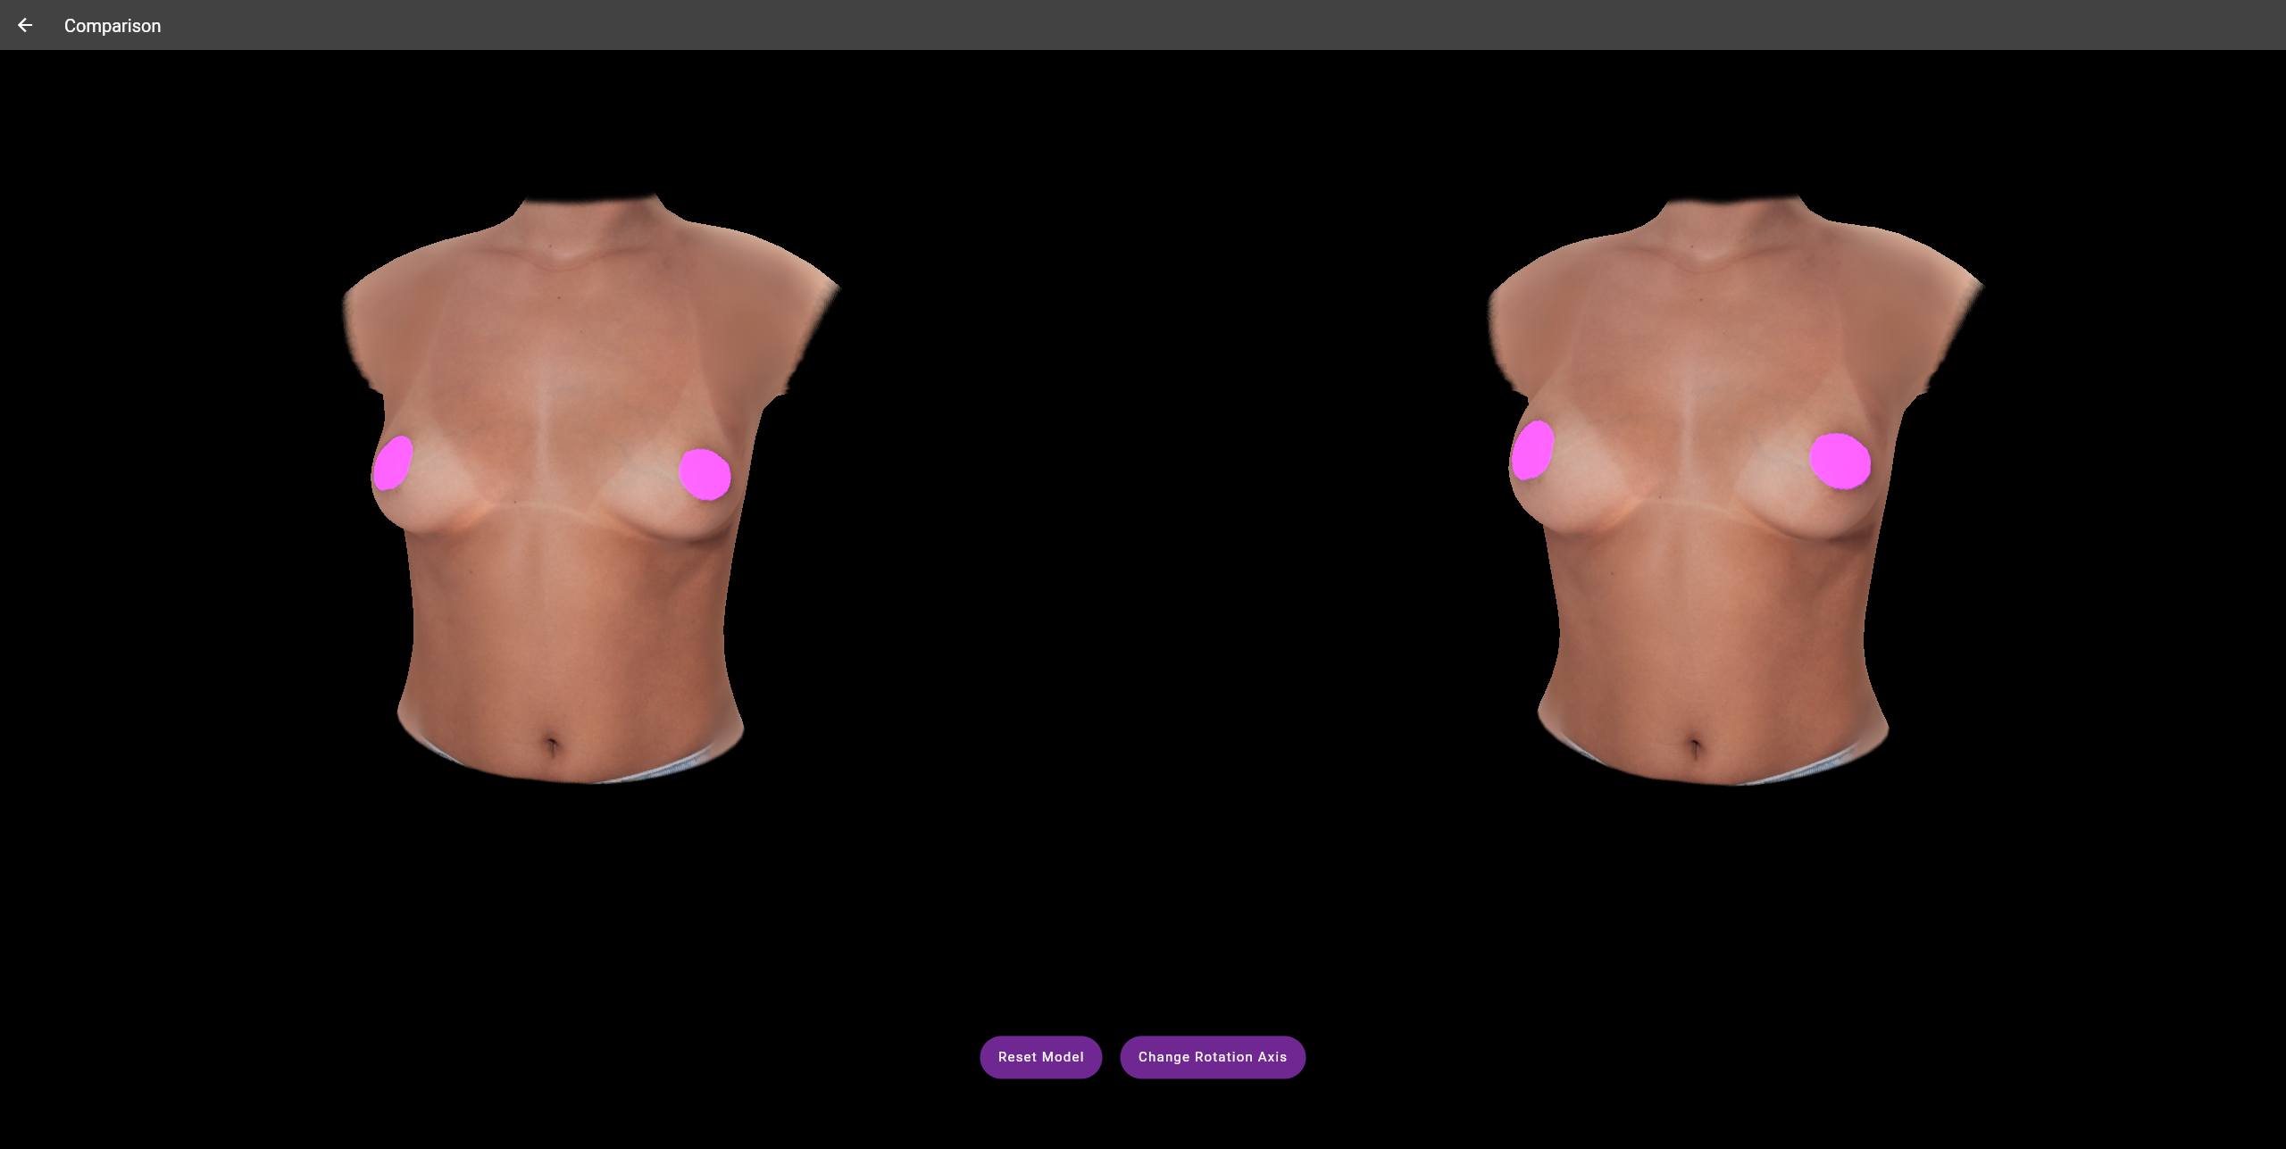
Compare Models
Notes:
As the final functionality we want to give the user we want to compare the models side by side

Slide 20

Live Demo
Notes:
In conclusion
-achieved goals
Limitations:
-correction UI from 2 angles

Slide 21
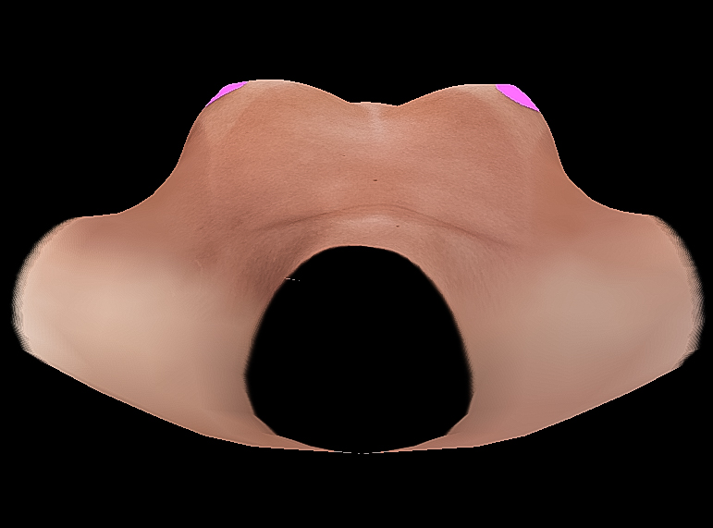
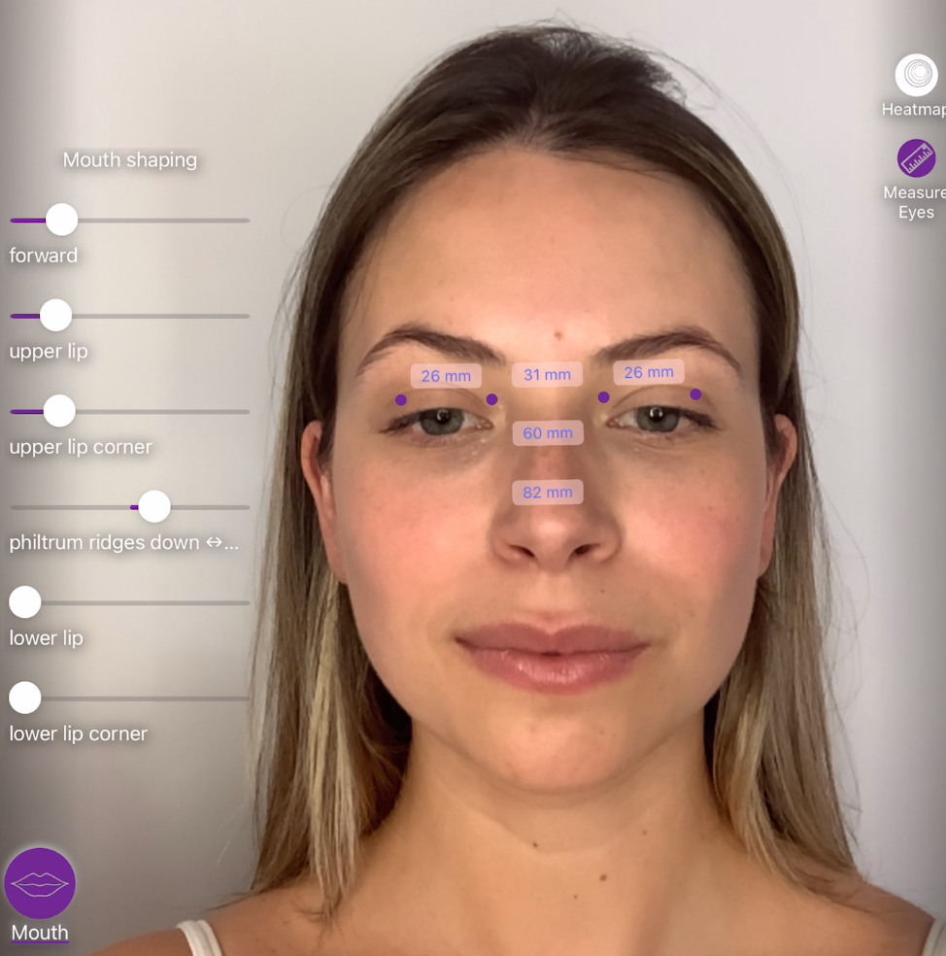
Outlook and Future Work
Line fitting from different perspectives
Change breasts individually
Offline version
Arbrea Face implementation

Slide 22
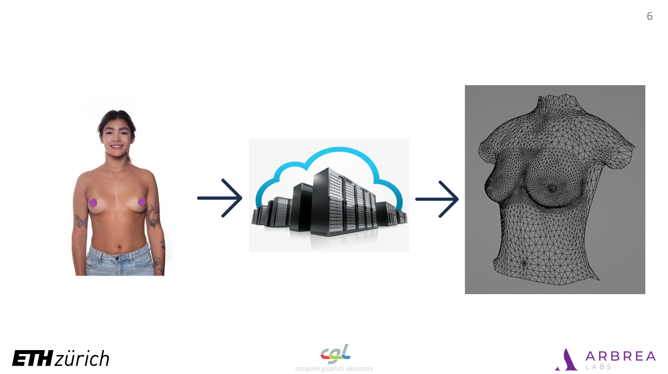
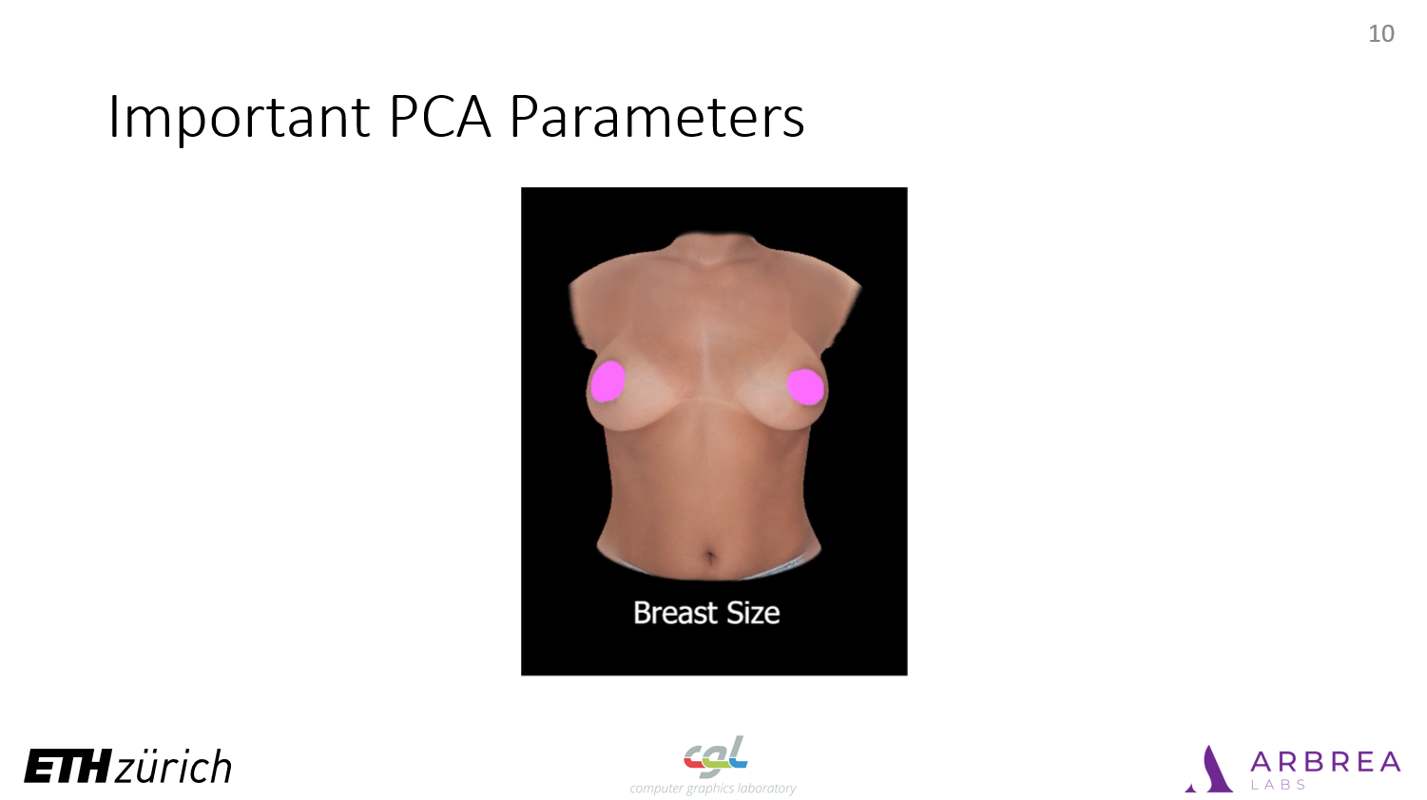
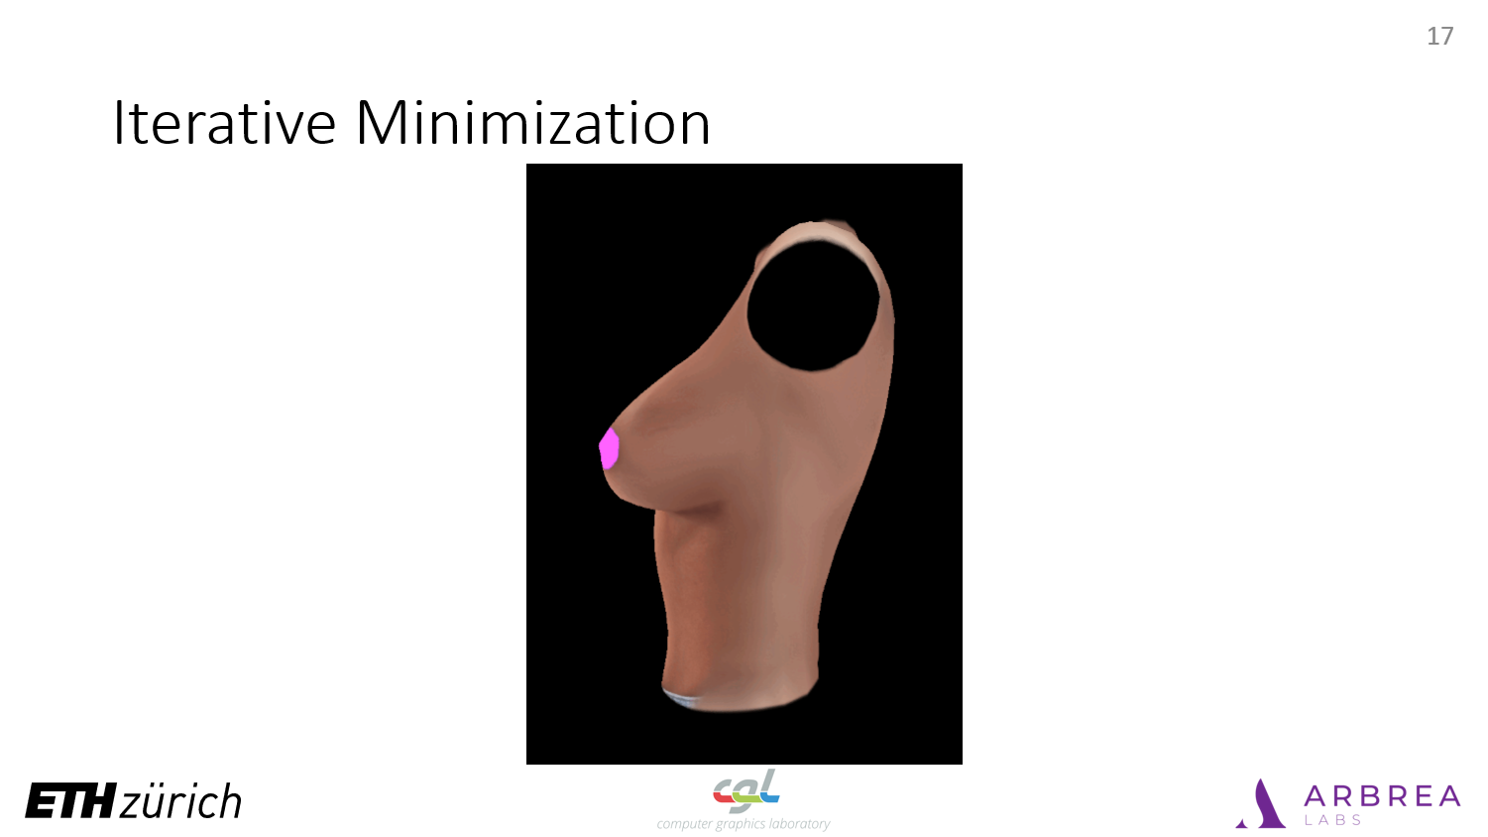
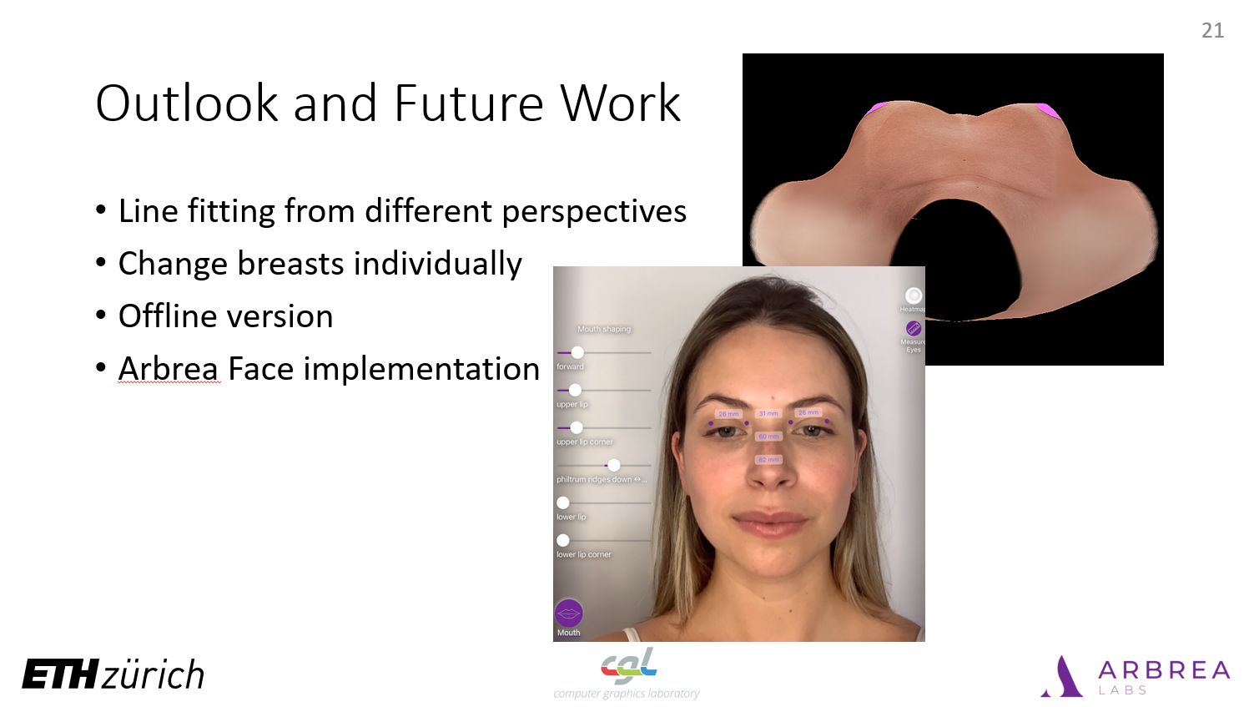

Slide 23
Additional slides for answering questions

Slide 24
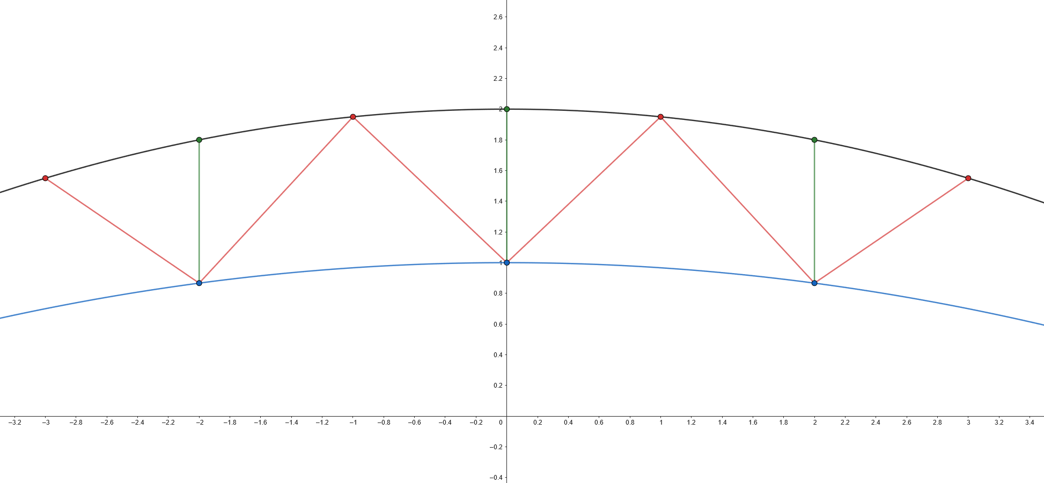
Calculating Distances
Notes:
Now that the drawn line is a set of points and the silhouette is a set of points we need to calculate a distance, which we can minimize.
We do this by calculating for each vertex on the silhouette the closest distance to a vertex on the drawn line

Slide 25




Pipeline

Slide 26
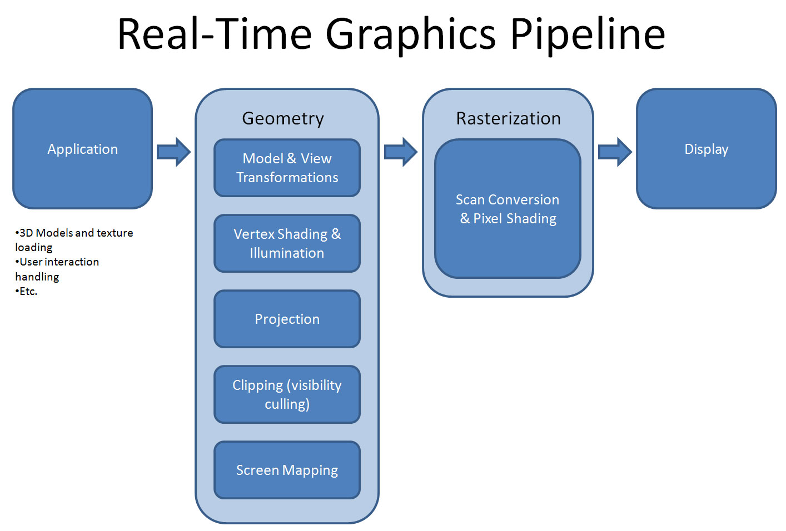

Slide 27
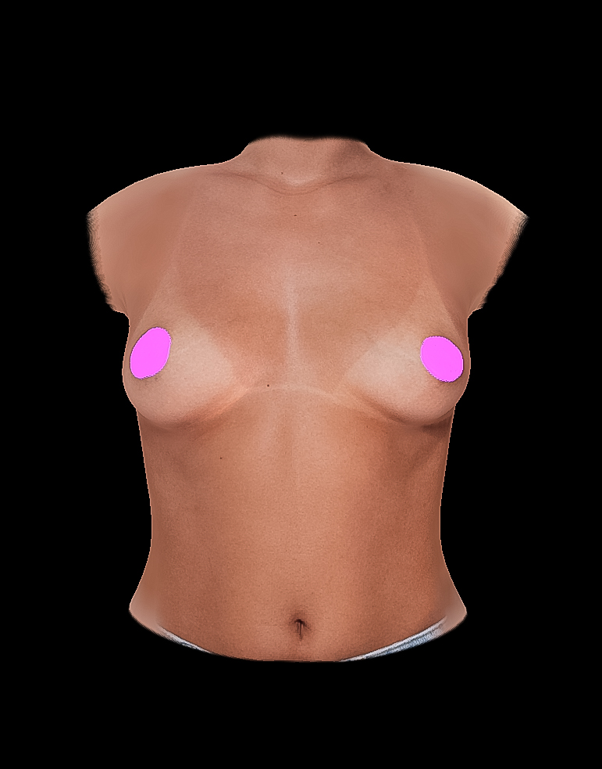
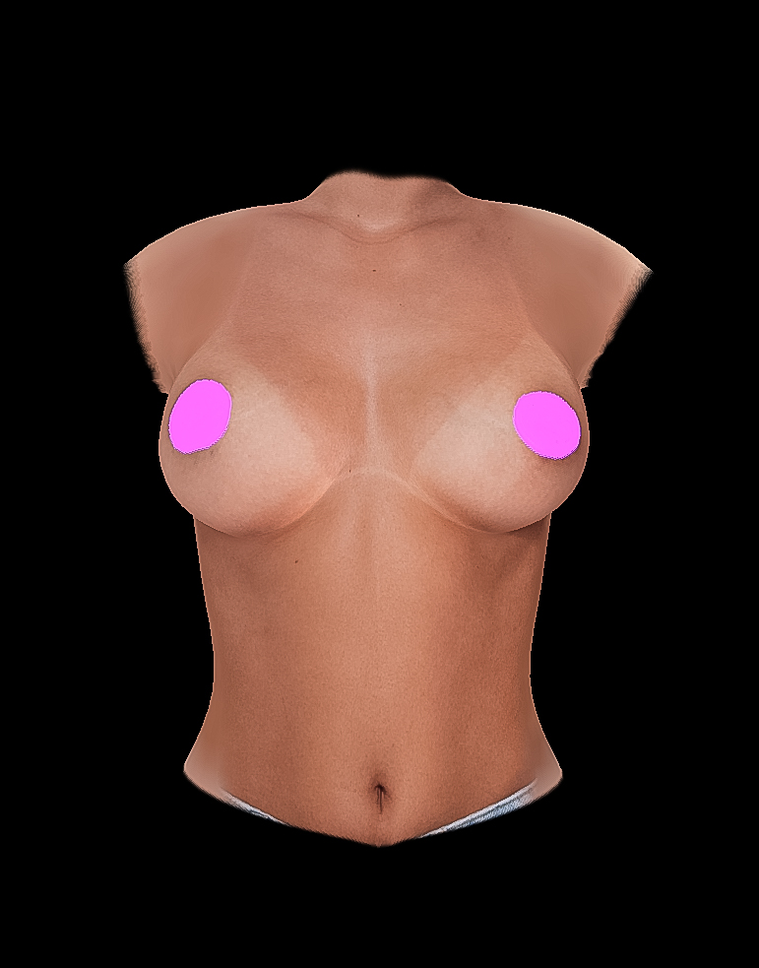
Torso Deformation

Slide 29
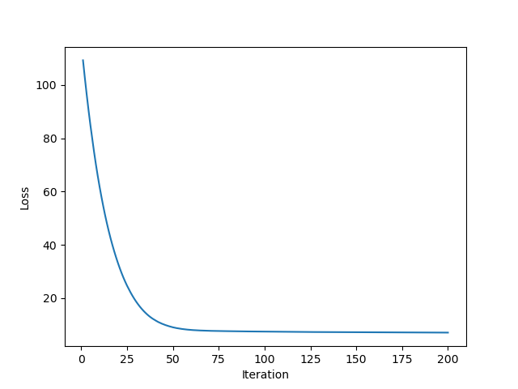
Loss vs Iterations

Slide 30
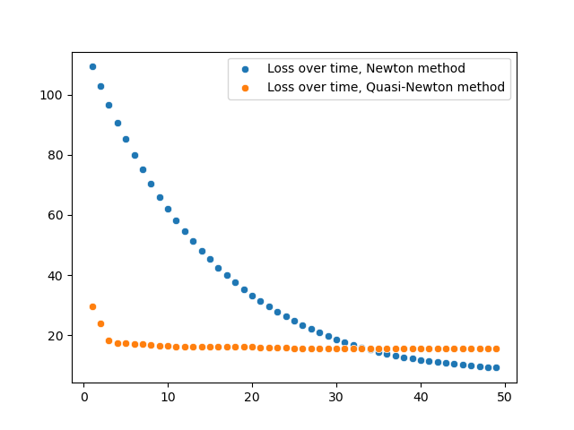
Newton vs L-BFGS-B

Slide 31
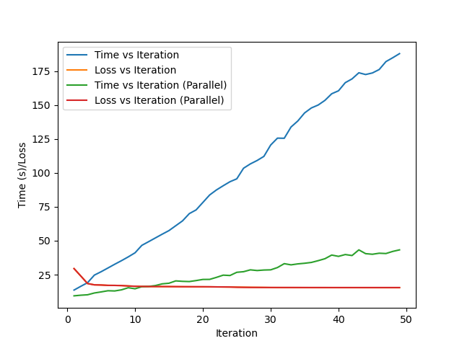
Serial vs Parallel L-BFGS-B

Slide 32
Add slides
Photo of tablet

Slide 33



Data Acquisition and Processing
Notes:
For data acquisition we have three steps
-Take images of patient
-somehow process into 3D representation
-get 3D model, with vert, faces, etc
Lets take a look at how to get the patient’s images

Slide 34


Notes:
Back at pipeline, we now have the patient data, we need to get a 3D representation, lets take look at our solution

Slide 35
Notes:
We now offloaded the task of processing the images to 3D representation, and introduced communication with our server
In a last step we take a look at our 3D model.

Slide 36
3D Model
Notes:
Wavefront obj format. Consists of .obj, .mtl, texture
3354 vertices

Slide 37

Vector length: 10062
Vector length: 30
Vector length: 10062
Vector length: 30
Notes:
PCA allows us to represent model with 30 numbers. By changing these numbers we can change the model, simplifying the model modification, while keeping the original torso shape
Lets take a look at the interesting principal component

